Slide 1
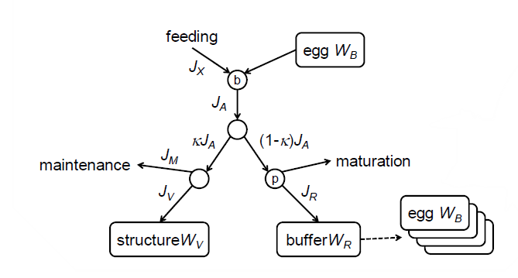
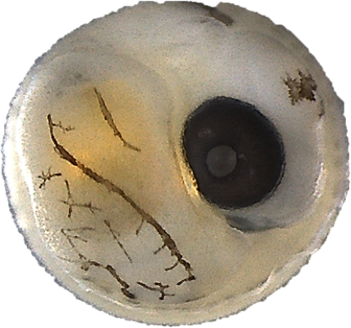
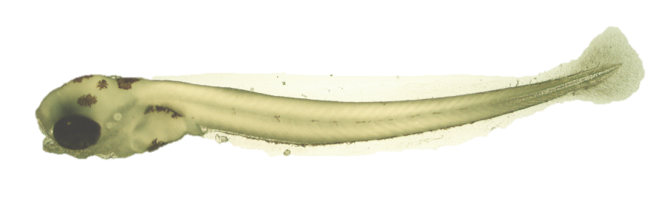
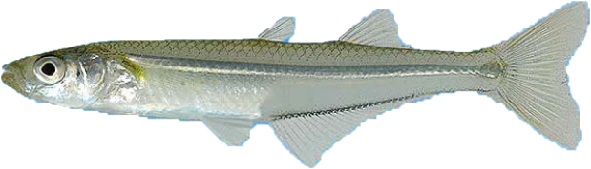
Full Life Cycle Energy Budget
Stage Specific Survival
Embryo mortality rate (μ_{emb})
y_{VA}
y_{BA}
Post-hatch mortality rate (μ_{lar})

Slide 2
Egg (W_{B})
Feeding

